Slide 1
Managing the Written Examination Tools

Slide 2
Learning Objectives
At the end of the session, you will be able to:
  Describe the different written examination tools
  Understand the purpose of the written examination tools
  Understand how to grade the written examination

Slide 3
Module Contents
Different written examination tools
Purpose of the written examination tools
Grading the written examination

Slide 4
Certification Requirements
Examination Type | Passing Score
 | Initial Certification | Recertification
Written | 80% | 80%
Practical | 100% | 100%

Slide 5
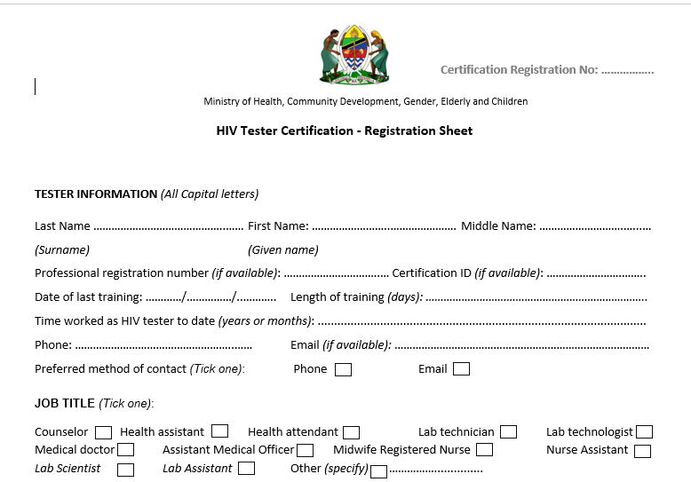
1. Registration Sheet (1)

Slide 6
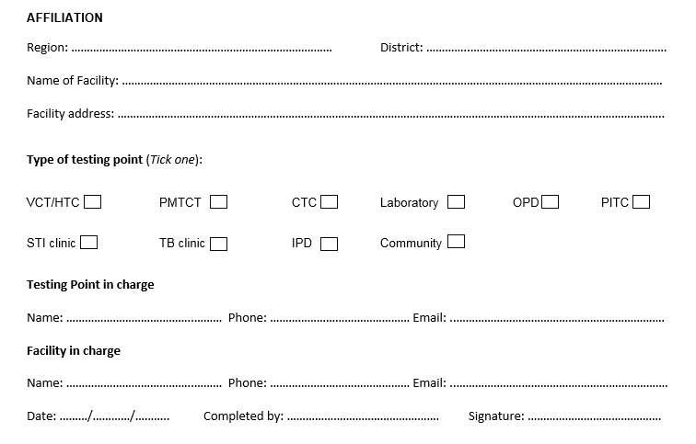
1. Registration Sheet (2)

Slide 7

2. Written Examination Questions Version

Slide 8
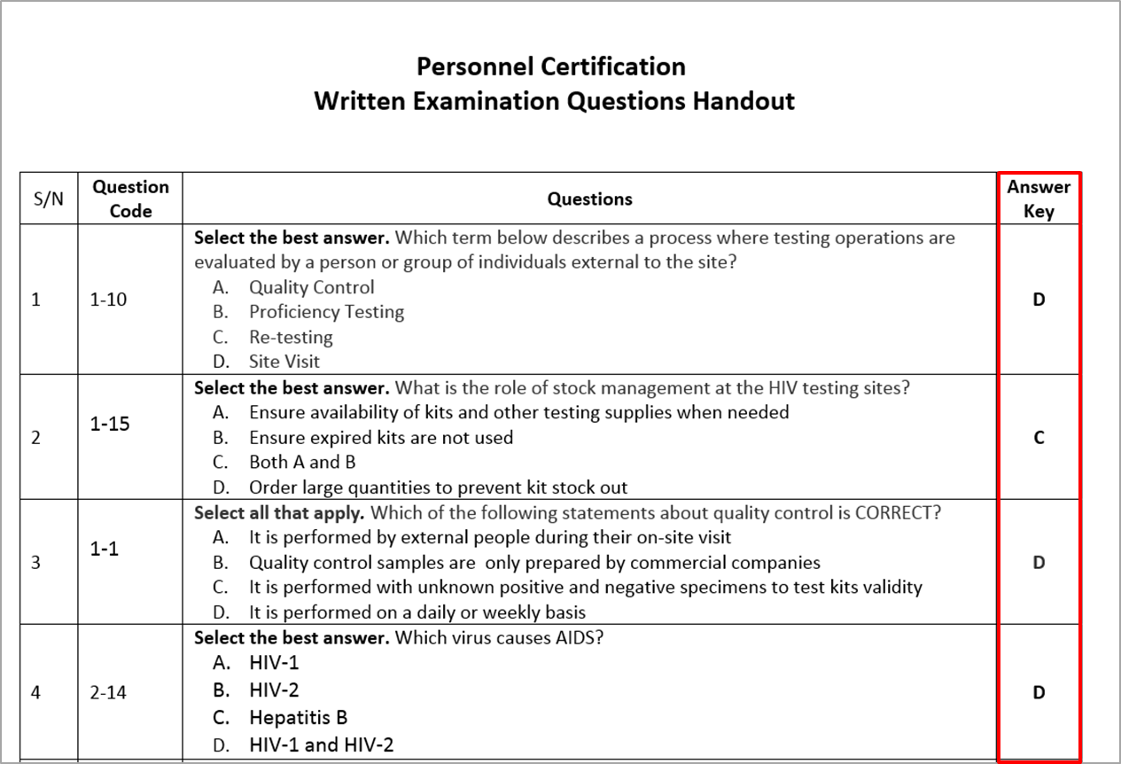
3. Written Examination Questions with Answer Key for Evaluator

Slide 9
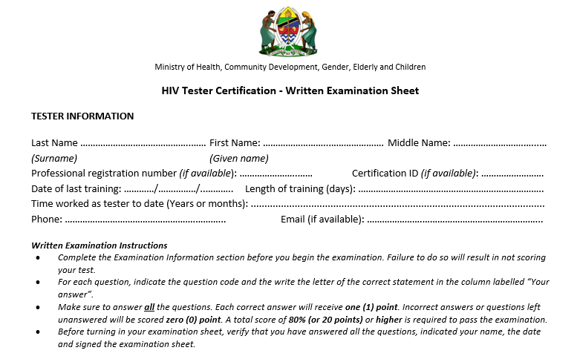
4. Completing the Written Examination Sheet (1)

Slide 10

4. Completing the Written Examination Sheet (2)

Slide 11
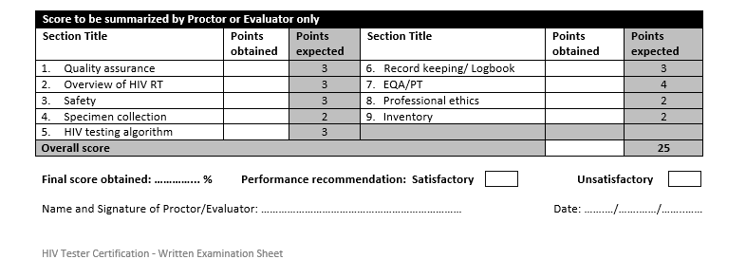
4. Completing the Written Examination Sheet (3)

Slide 12
Roles and Responsibility
Tools | Tester | Evaluator/ Proctor
Registration Sheet | Complete | Review and sign
Written Examination Question version | Use as resource during the examination | Keep before and after examination
Written Examination Question version with Answer key | DOES NOT NEED | Use to grade examination
Examination Result form | Use to record exam answer | Review and grade

Slide 13
Summary
What are the different written examination tools?
Who uses the Written examination question version
Who uses the Written examination question version with answer key?
How is the written examination graded?

